Slide 1
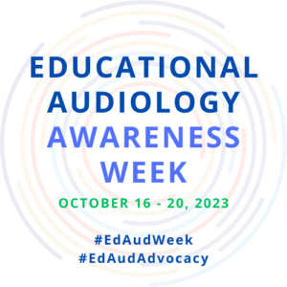
#EdAudWeek #EdAudAdvocacy
Presenter Name

Slide 2
The goal for establishing an Educational Audiology Awareness Week is to foster public awareness and knowledge of educational audiology services including the benefits that these essential services provide to children, their caregivers, and other professionals.
Vision

Slide 3
Outreach
Community Information

Slide 4
Outreach
Administrator Information

Slide 5
Outreach
Teachers
October 16 – 20, 2023
#EdAudWeek #EdAudAdvocacy

Slide 6
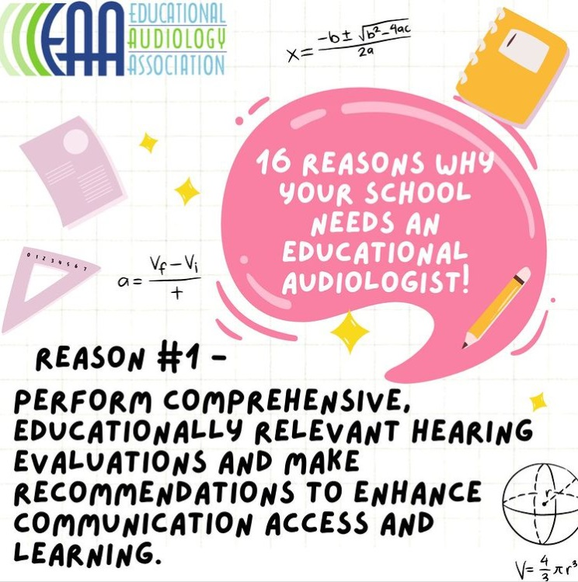
16 Reasons
WHY YOUR SCHOOL NEEDS AN EDUCATIONAL AUDIOLOGIST
October 16 – 20, 2023

Slide 7
Thank you
Presenter name
Email address
Website
Notes:
Top: Dr. Stephanie Williams and patient at the UT-Dallas Callier Center for Communication Disorders
Bottom: Dr. Kim Fiorentino and patient at the UT-Dallas Callier Center for Communication Disorders.

